Slide 1
Nervous System Recap

Slide 2
Divisions - Sensory
Sensory:
detects information about internal and external environment.
Receptors detect information:
Rods and cones in retina
Ciliated cells in cochlea in ear
Taste buds on tongue
Olfactory buds in nasal cavity
Proprioceptive fibres in joints and muscles (position in space)
Receptors in skin for pressure, temperature and pain
Stretch receptors in muscles and walls of internal organs
Chemoreceptors/baroreceptors/thermoreceptors in hypothalamus and blood vessels

Slide 3
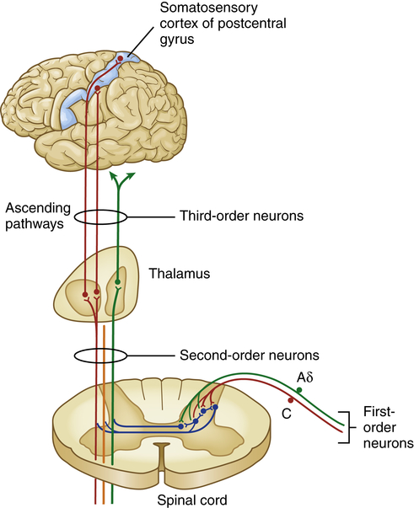
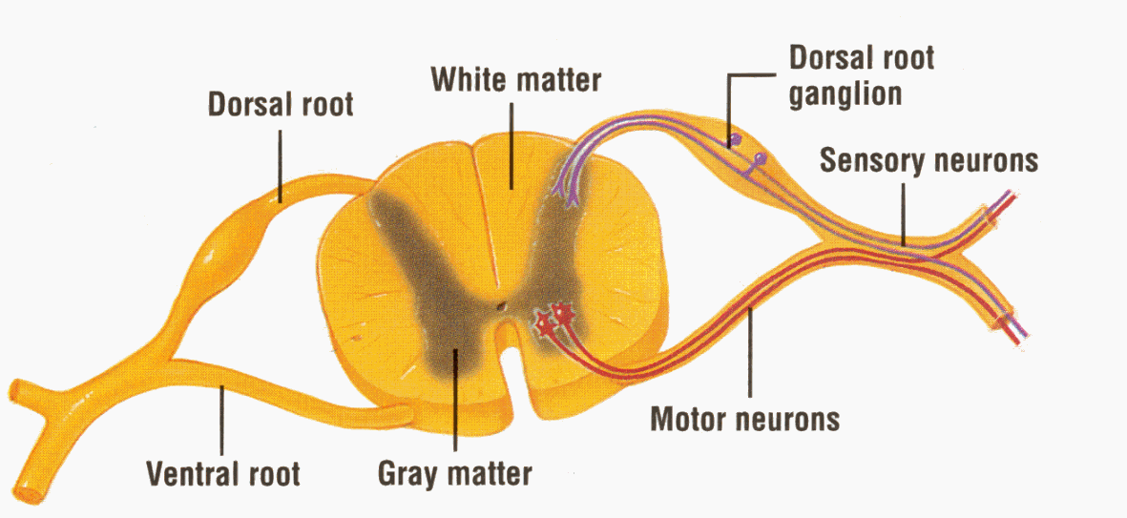
Divisions - Sensory
Once information has been received about surrounding environment, signals are sent via sensory neurons to the CNS (brain and spinal cord)
Sensory neurons that take info to spinal cord are:
Pseudounipolar
Have cell bodies in the dorsal root ganglion of the spinal cord
ACh is the neurotransmitter at synapses

Slide 4
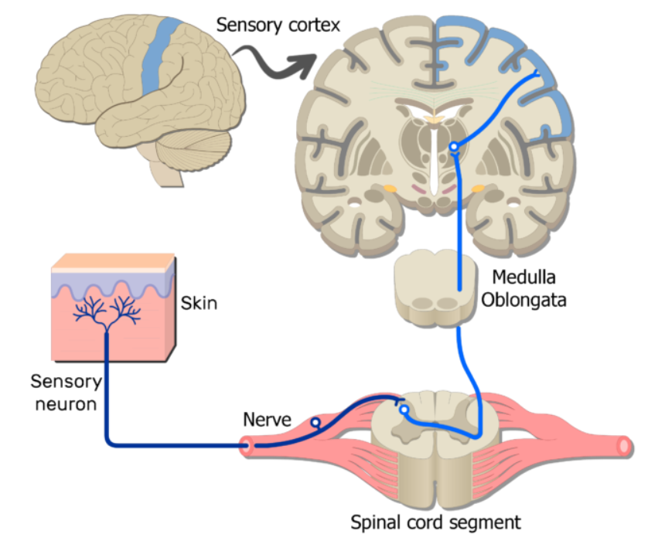
Divisions - Sensory

Slide 5
Divisions – CNS (Central Nervous System)
Brain and spinal cord together make up the CNS
Sensory information is received and processed, and then signals are sent out via the motor divisions for action.

Slide 6
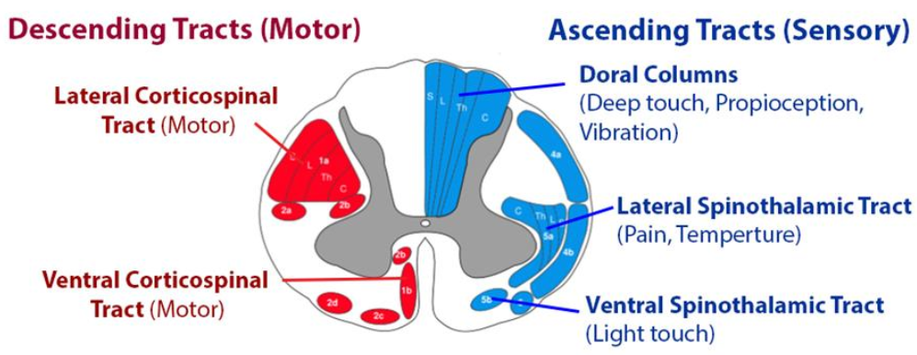
Divisions – CNS – Spinal Cord
Spinal Cord
Bundles of neurons (called tracts)
Sensory “ascending” tracts: take info up to brain from sensory neurons
Motor “descending” tracts: take info away from brain and back to effector muscles and glands
Many pathways involve a chain of neurons in spinal cord with multiple synapses
Eg sensory pathways from skin, up spinal cord to brain.

Slide 7
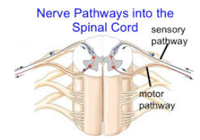
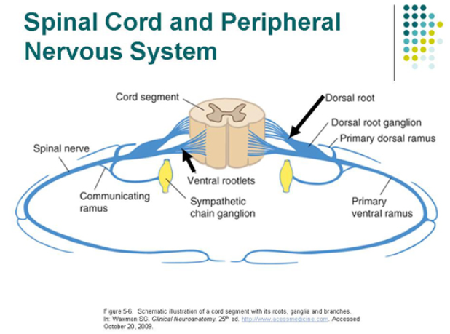
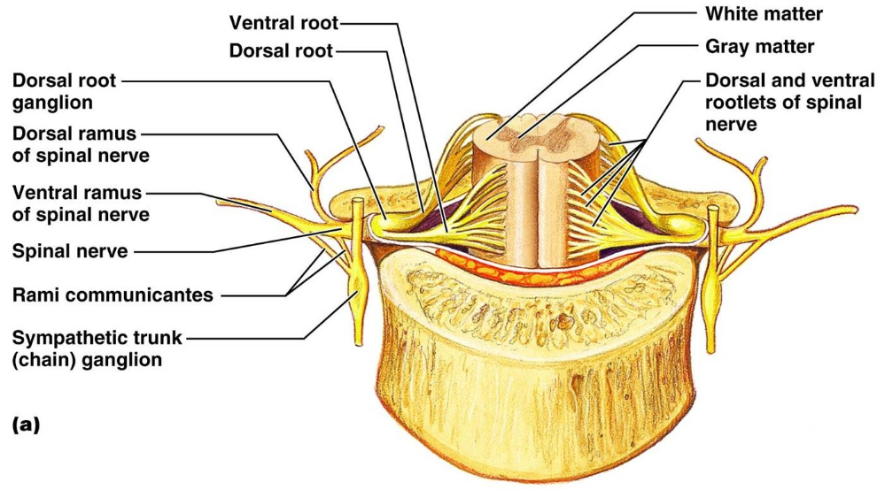
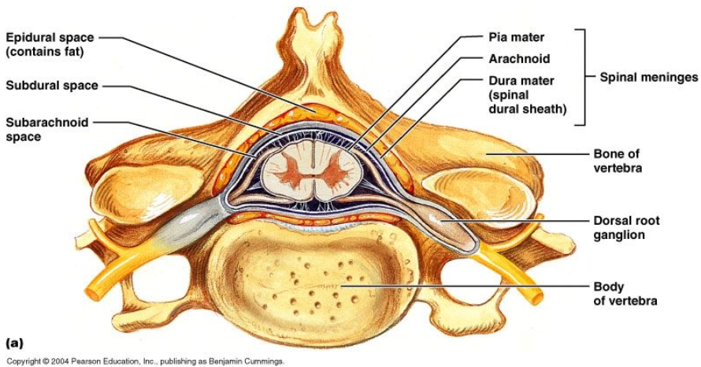
Divisions – CNS – Spinal Cord

Slide 8
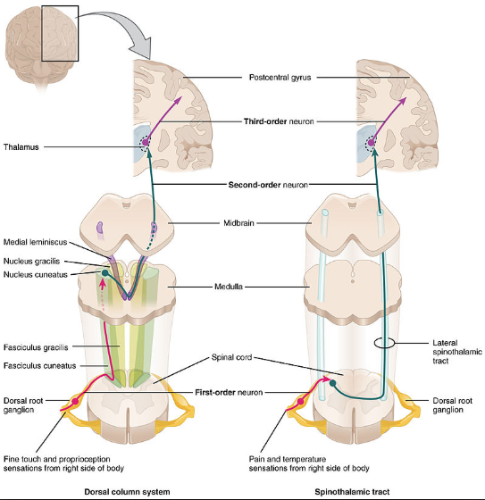
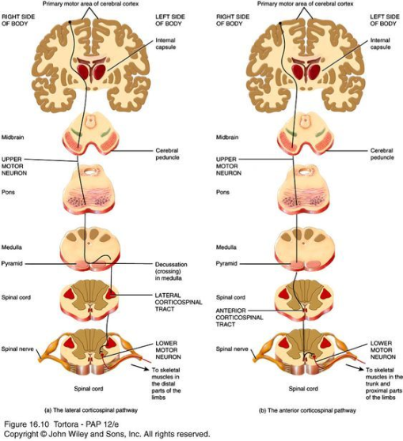
Divisions – CNS – Pathways to and from Brain

Slide 9
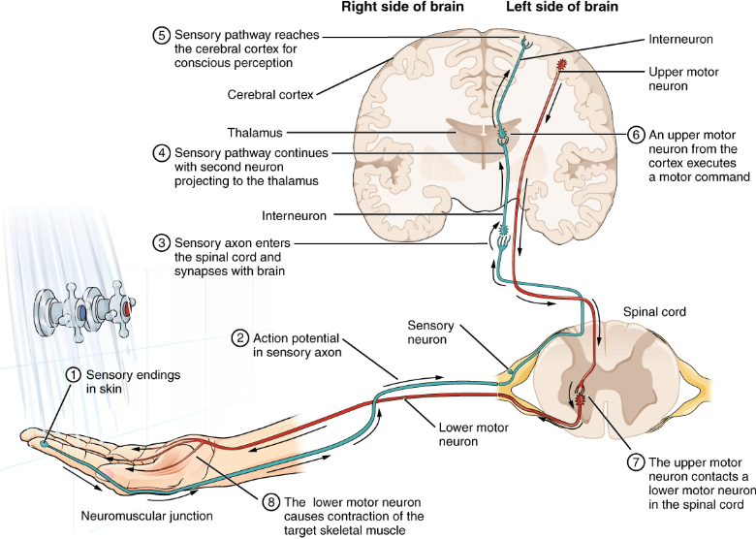

Slide 10
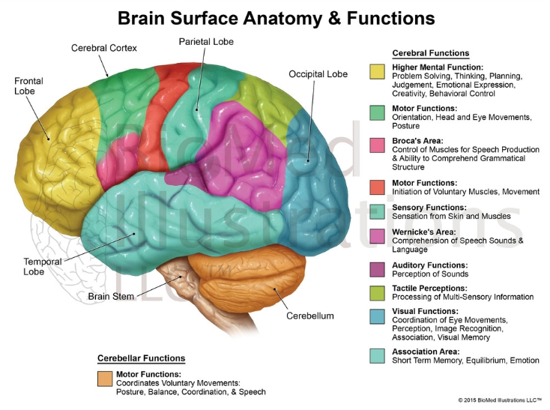
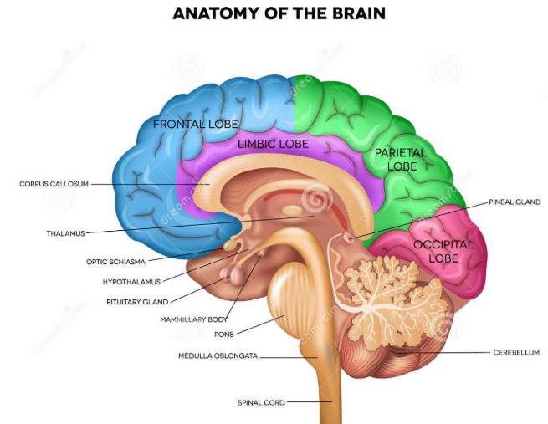

Slide 11
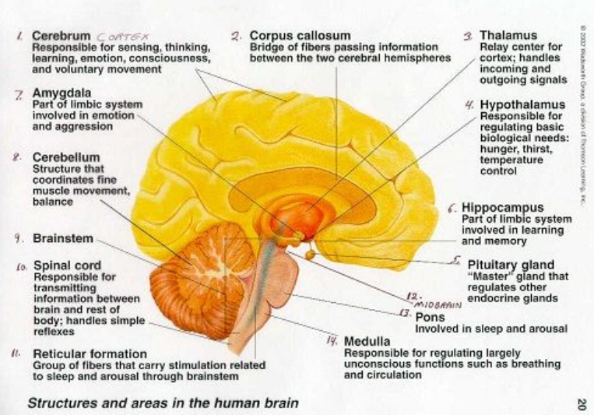

Slide 12
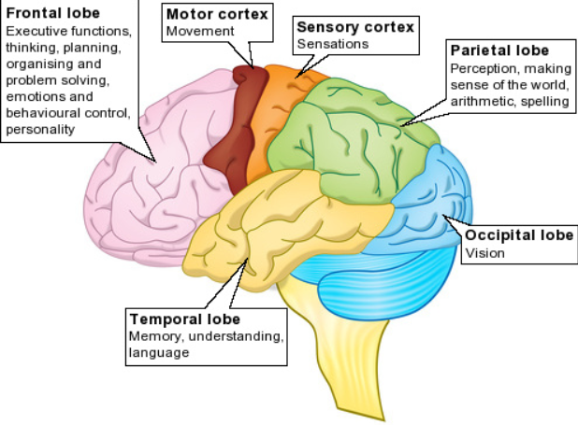

Slide 13
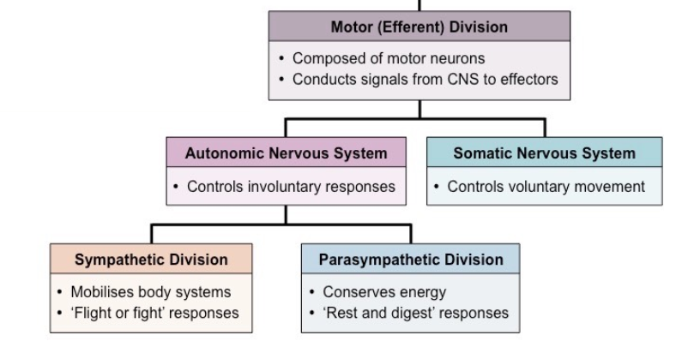
Divisions – Motor
Output/Action
Messages from CNS (brain and spinal cord) sent to muscles and glands
Divisions within the Motor NS

Slide 14
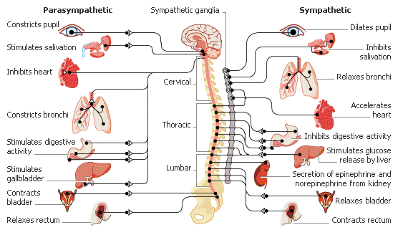
Divisions- Motor > Autonomic

Slide 15
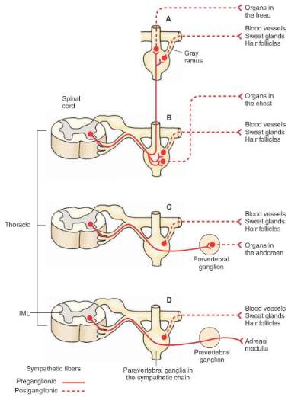
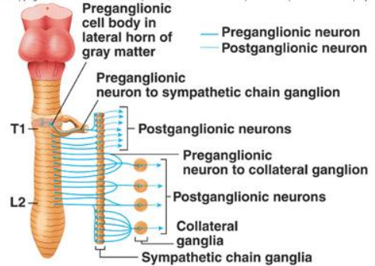
Divisions – Motor > Autonomic >Sympathetic

Slide 16
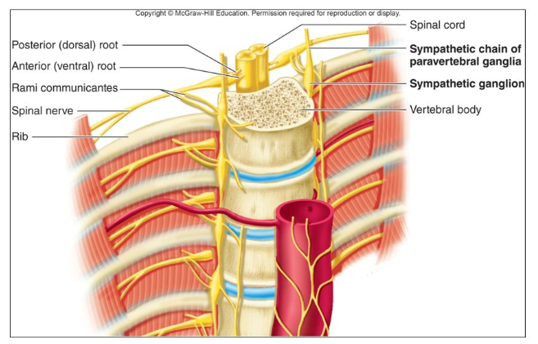
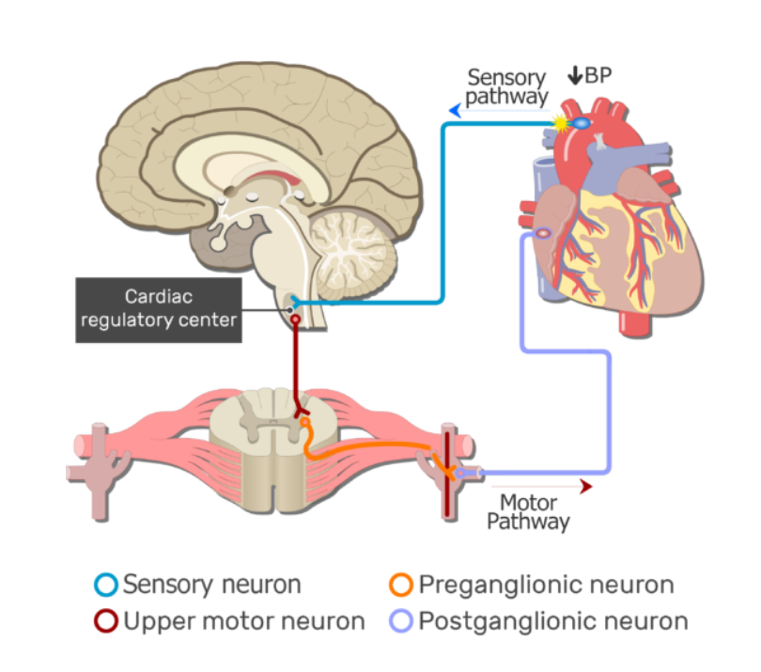
Divisions – Motor > Autonomic >Sympathetic

Slide 17
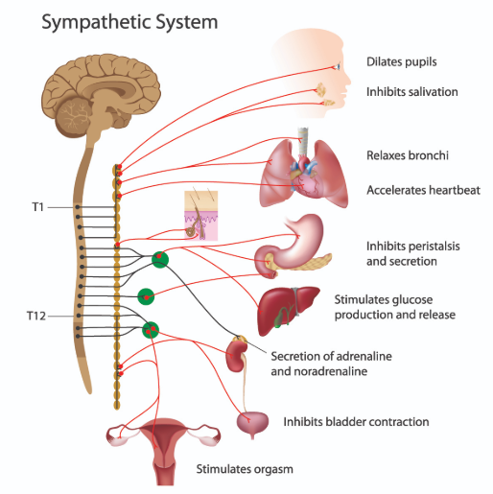
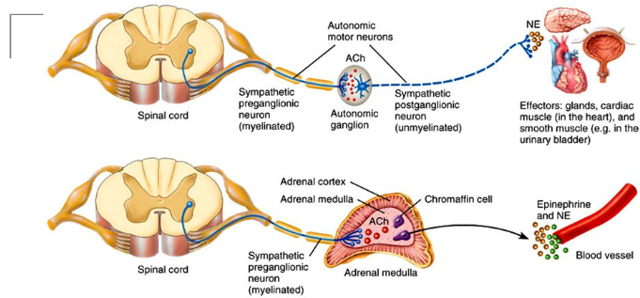
Divisions – Motor>Autonomic>Sympathetic

Slide 18
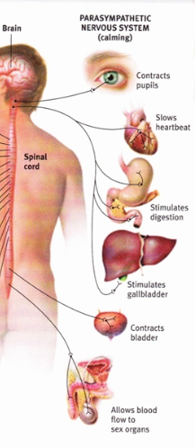
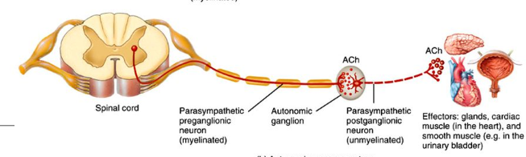
Divisions- Motor>Autonomic>Parasympathetic
Note: Parasympathetic neurons exit spinal cord at Brain, Cervical Spine and Sacral (pelvic) spine only

Slide 19
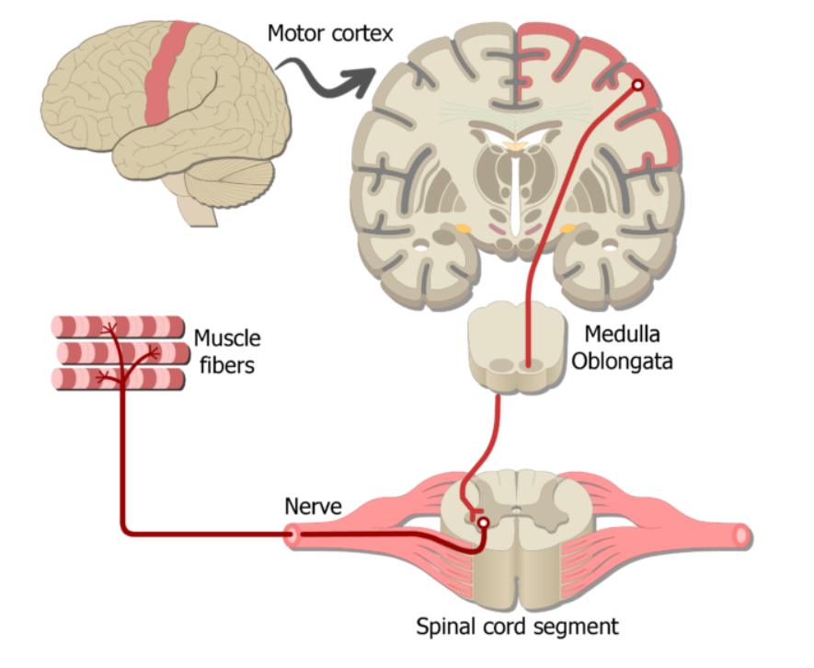
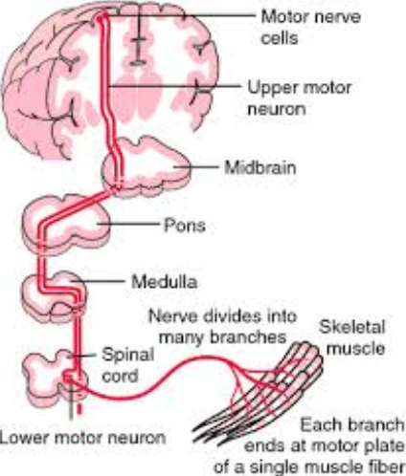
Divisions – Motor >Somatic

Slide 20
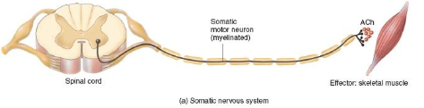
Divisions – Motor>Somatic

Slide 21
